Slide 1
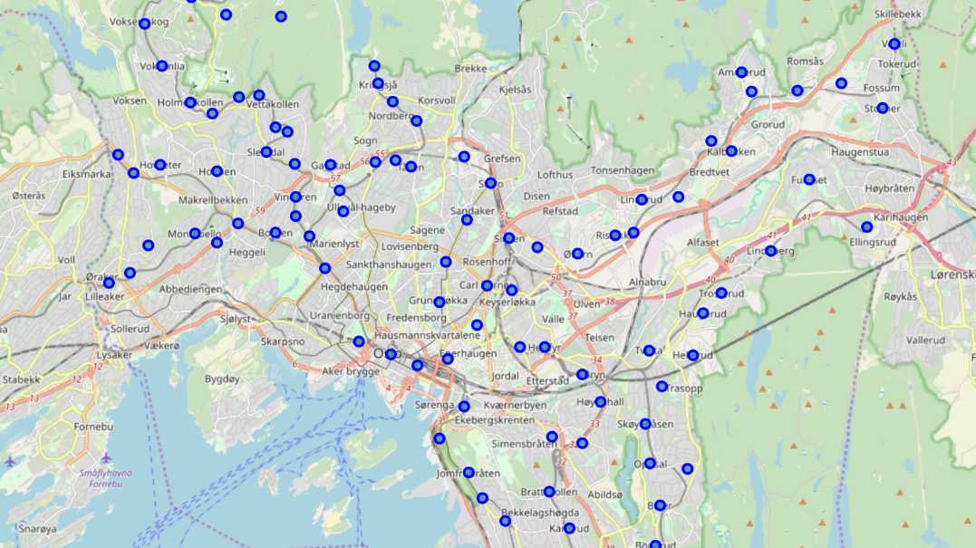
An Analysis of the Culinary Scene in Oslo, Norway – using K-Means, Foursquare and GeoPy
Assignment for the 'Data Analytics using Python'-course at UC San Diego Extension
by Arne Martin Fevolden
Course instructor: Michael Galarnyk
Summer Semester, 2019

Slide 2

Background & Inspiration
The assignment is submitted in fulfilment of the requirements for the 'Data Analytics using Python'-course ‘Option B: Improve a Python project from another class.’
The original inspiration for the analysis comes from the Capstone project for the IBM Data Science Professional Certification (offered through Coursera), which I completed in April 2019. The IBM Capstone assignment involved using FourSquare venue data and K-means cluster analysis to carry out an analysis of our own choosing. My project analyzed the restaurant sector in Oslo. (https://github.com/enraarne/Coursera_Capstone).
This assignment draws on the Capstone project in the sense that it also analyses the restaurant sector in Oslo and employs both Foursquare data and K-means cluster methodology. Apart from that, the analysis has been completely reworked. Among many improvements, it could be mentioned that the new analysis is based on a much bigger data set, uses GeoPy Nominatim for geocoding, employs more effective coding strategies and more sophisticated use of web scraping and the FourSquare API.

Slide 3
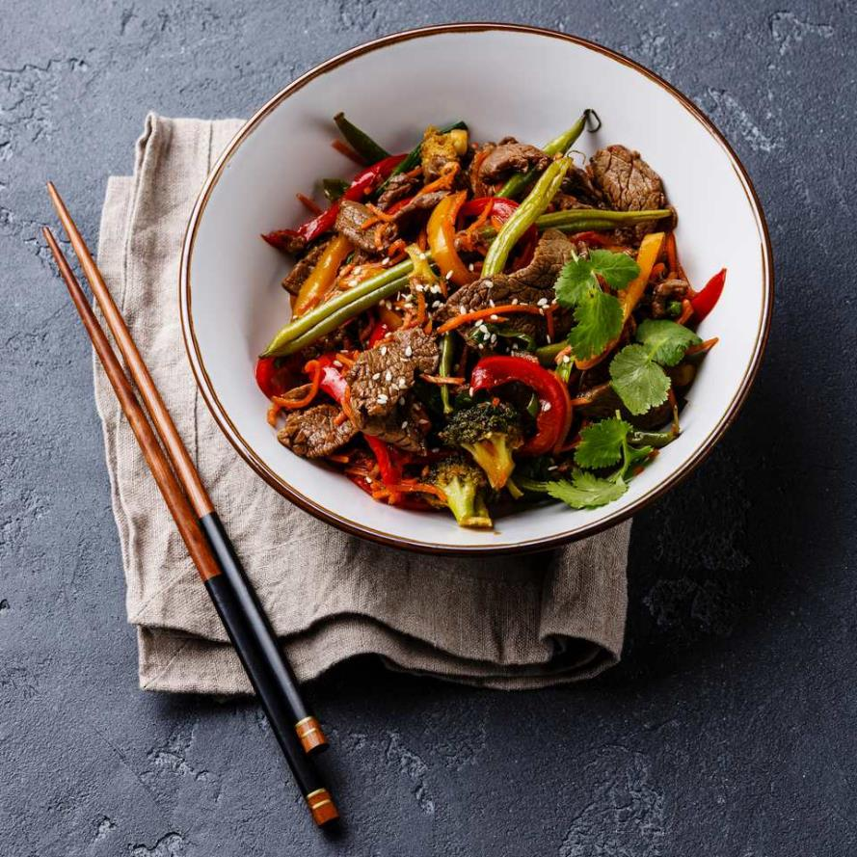
The Case:
The owners of the fictitious Chinese restaurant ‘Food Scientist’ (食品科學家) want to find a good location for opening another restaurant in Oslo.

Slide 4
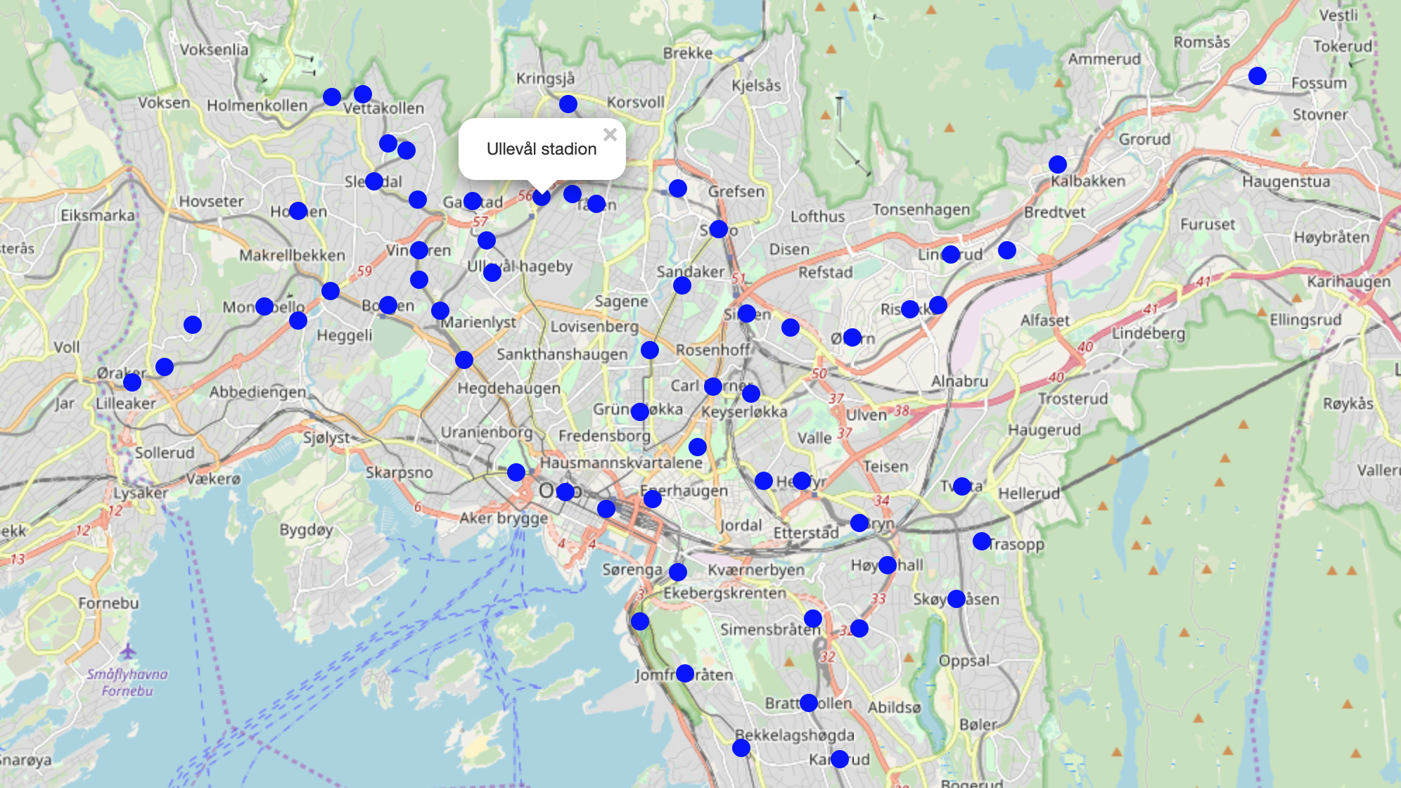
Location of their existing restaurant

Slide 5
A good location for a new restaurant …
Strong demand for the restaurant’s services
Demand: A good measure for demand is the presence of restaurants that are similar to those located around Ullevål Stadion.
Food Scientist fits in well with the lifestyle and food choices of the people living and working at Ullevål Stadion, and a new restaurant should be located where it can cater to similar groups of diners.
Moderate competition from other restaurants
Competition: A good indicator for competition is the presence of Chinese and other Asian restaurants.
Other Chinese restaurants impart direct competition since their food is almost identical, while other Asian restaurants impart a more indirect form of competition since their food is similar.

Slide 6
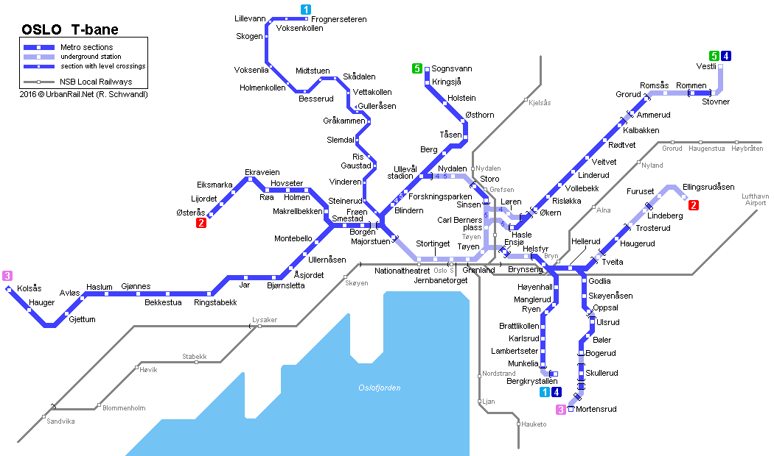
How do we find potential restaurant locations?
There is no established way of defining restaurant districts in Oslo.
Since restaurants tend to cluster around public transit points, we will use the stations on the city's subway and tramway network as potential restaurant locations.

Slide 7

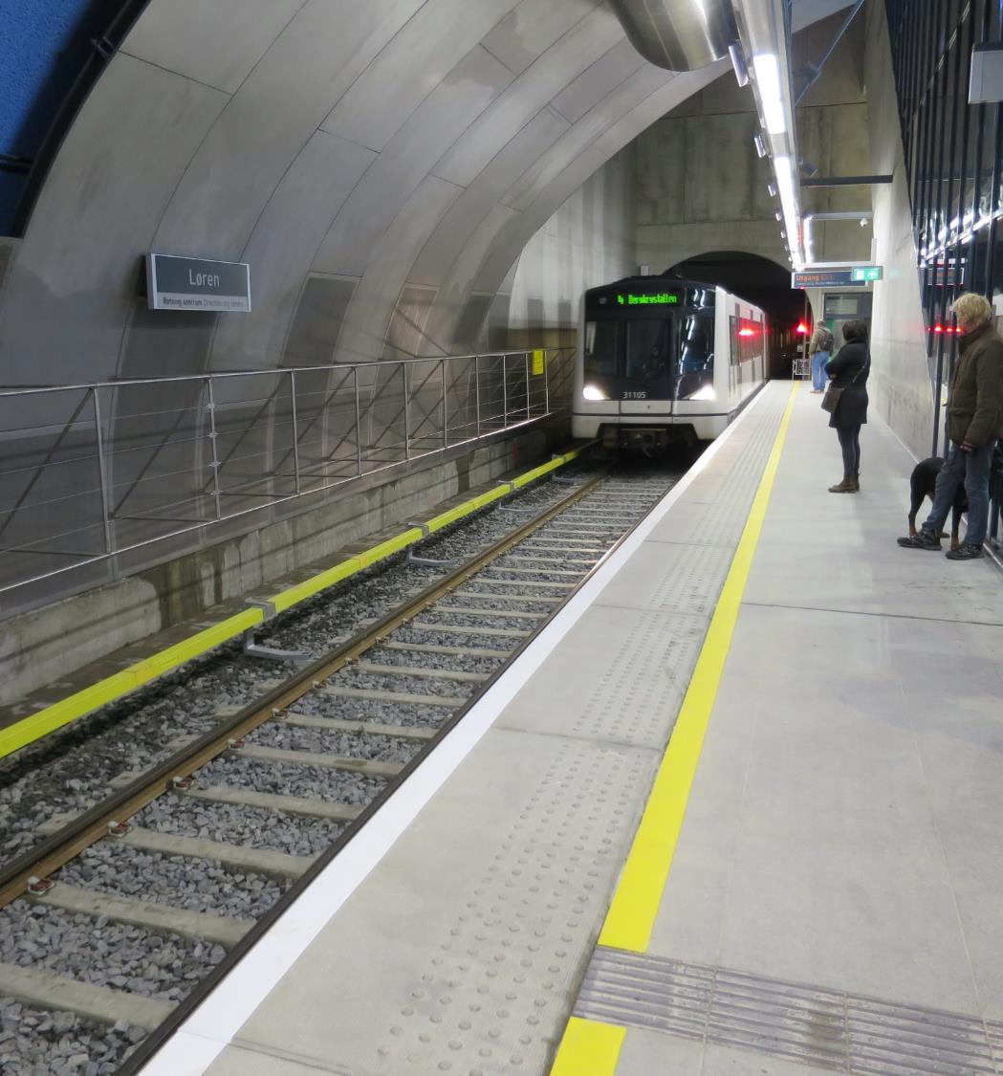
How will we carry out the analysis?
We will find all the restaurants in the vicinity of each station and use information about these restaurants to determine:
the level of competition in the surrounding area
the potential demand for a restaurant such as Food Scientist

Slide 8



Data:
Three types of data have been important in this analysis:
Subway and tramway stations from Wikipedia: The names of the subway and tramway stations were scraped from two Wikipedia pages.
Geolocation data from GeoPy: Geolocation data was used to find the Decimal Degrees (DD) coordinates for the different stations in Oslo. The coordinates were downloaded using GeoPy (https://geopy.readthedocs.io/en/stable/)
Venue data from Foursquare: Location data on venues was accessed and downloaded through Foursquare API (https://foursquare.com). The venues were selected by specifying an area in each district that was the size of a circle with a radius of 1000 meters for downtown locations and 2000 meters for residential locations.

Slide 9

Methods - Competition
Since Food Scientist is a Chinese restaurant, it is mostly concerned with competition from other Chinese restaurants (direct competition) and somewhat concerned with competition from other Asian restaurants (indirect competition). To measure the level of direct and indirect competition, we will employ the following formula:
Direct competition = The percentage of Chinese restaurants relative to other restaurants in the district
Indirect competition = The percentage of other Asian restaurants relative to other restaurants in the district

Slide 10
Methods - Demand
Demand will be measured as the degree of resemblance to Ullevål Stadion, in terms of the type of restaurant venues that are present in the districts. The degree of resemblance will be measured using K-means cluster analysis. K-means is an unsupervised machine learning algorithm that group the observations in a way that the distance is as small as possible inside the cluster and as big as possible between clusters. In our analysis, we will:
Determine the ideal number of clusters, using the Elbow method
Use K-means to group the restaurant districts into the different clusters, based on the types of restaurant venues that are located there.

Slide 11
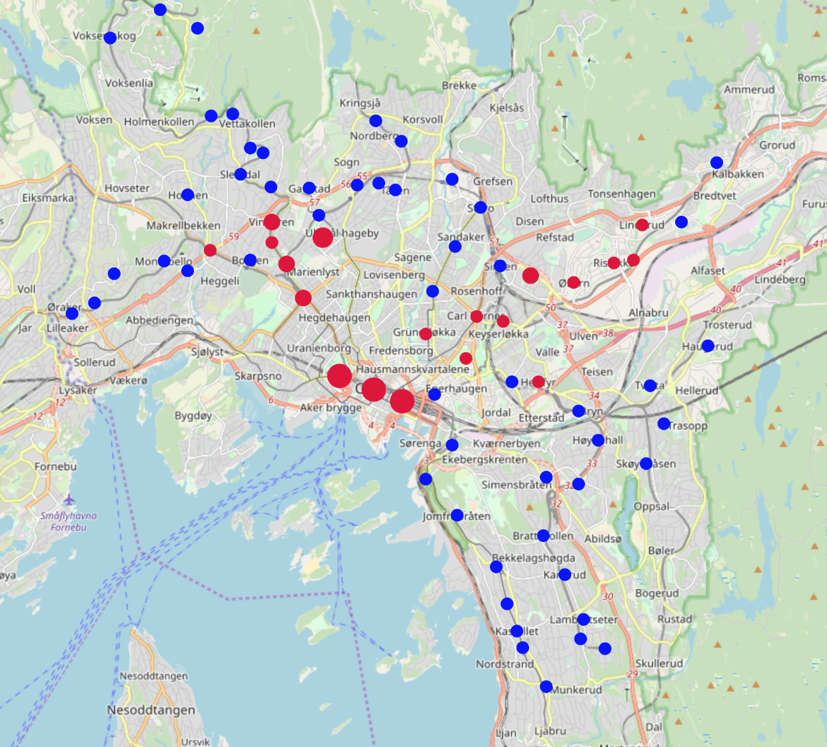
Direct Competition from other Chinese Restaurants:
- “Chinese restaurants are present in only a few restaurant districts.”
Red circle = Chinese restaurants (greater size, greater number)
Blue circle = No Chinese restaurants

Slide 12
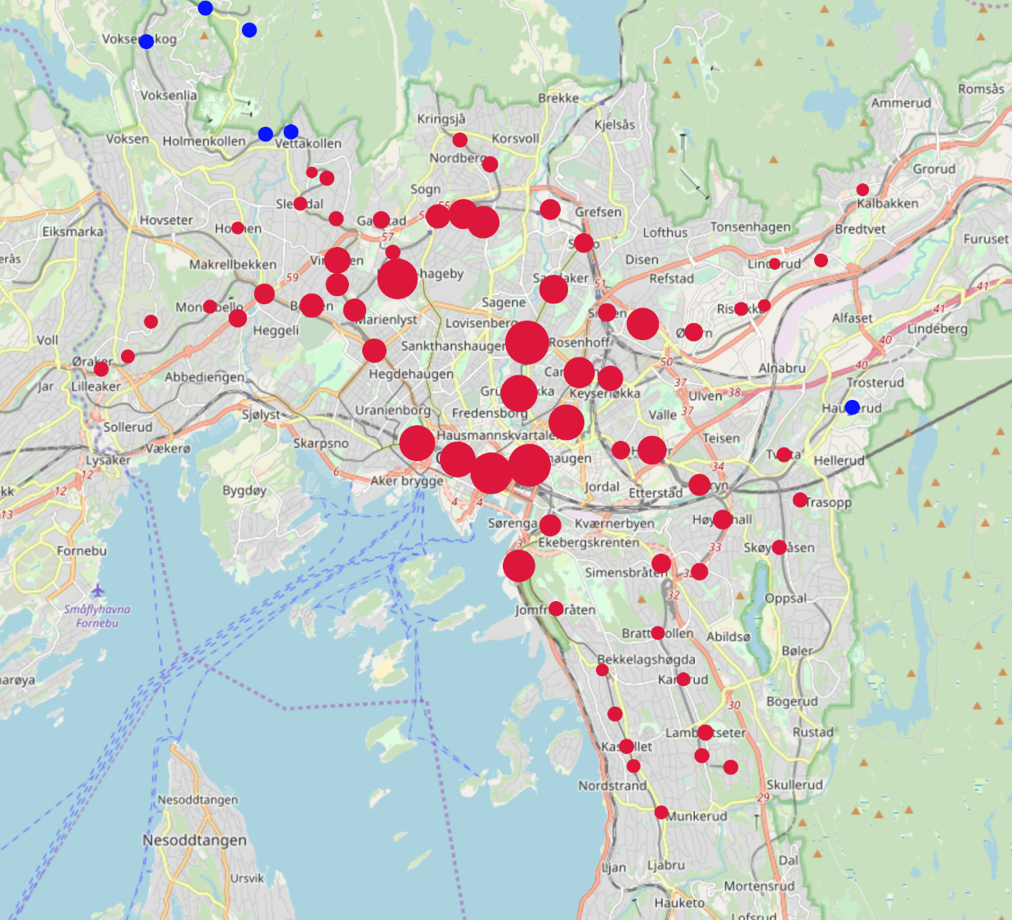
Indirect Competition from other Asian Restaurants:
- “Other Asian restaurants are present in most restaurant districts.”
Red circle = Other Asian restaurants (greater size, greater number)
Blue circle = No Asian restaurants

Slide 13
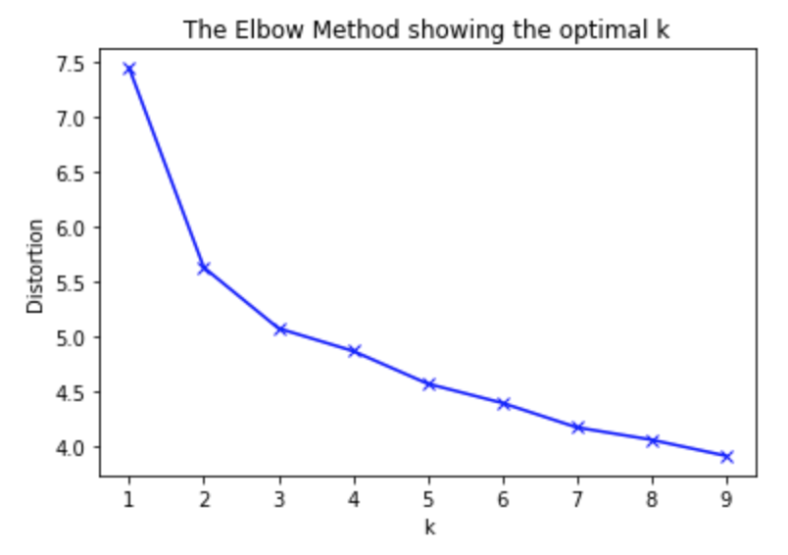
Elbow Analysis
Three clusters seem to be the best option

Slide 14
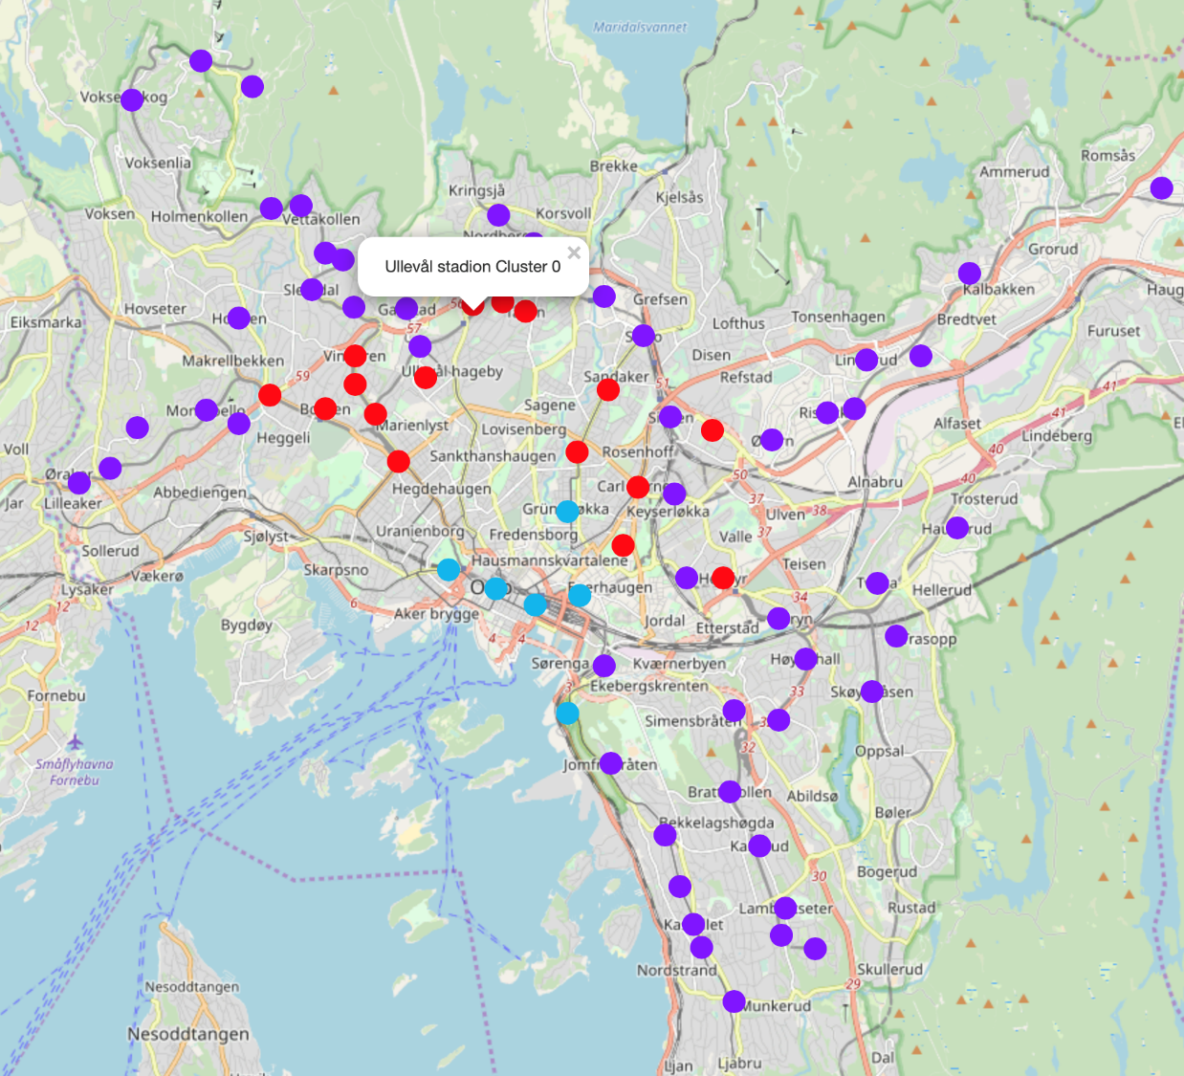
Cluster Analysis:
Blue-green: Downtown districts with many and diverse restaurant venues
Purple: Suburban districts with few and similar restaurant venues
Red: Mixed districts with a moderate number of restaurant venues with a fair amount of diversity
- “Food Scientist belong to a ‘mixed district’, and the new restaurant should be located in a district of the same type.”

Slide 15

Conclusion

Slide 16
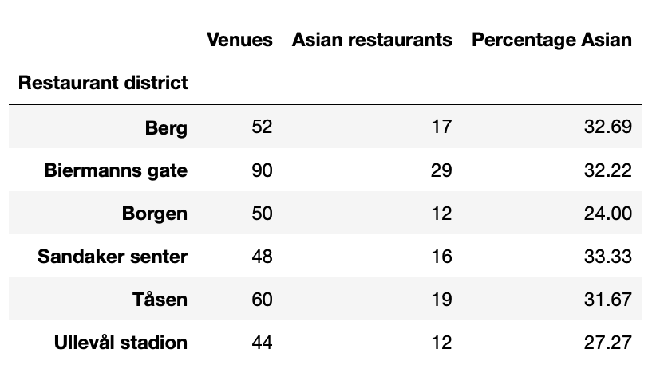
Good Alternatives:
If we only consider restaurant districts that:
present no direct competition from other Chinese restaurants
display strong similarities in taste with their existing restaurant

Slide 17
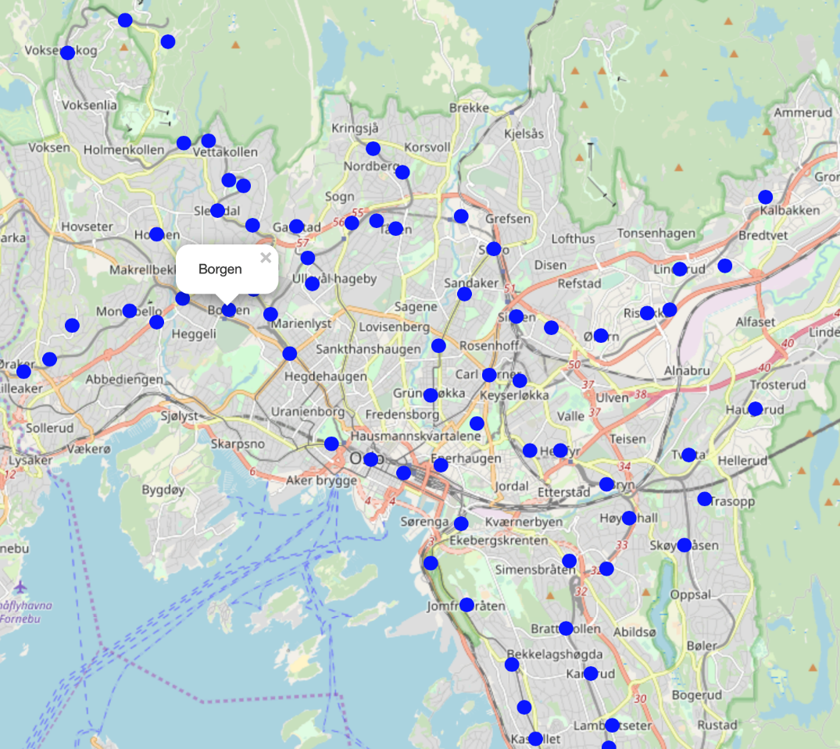
Best alternative

